Slide 1
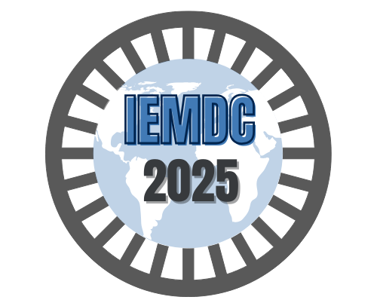





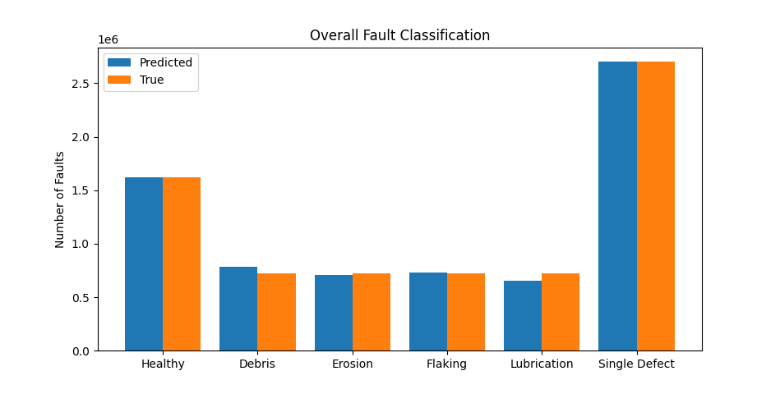
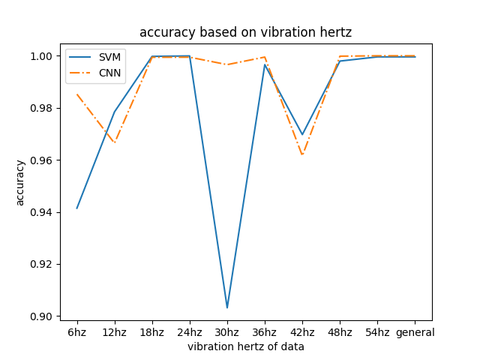
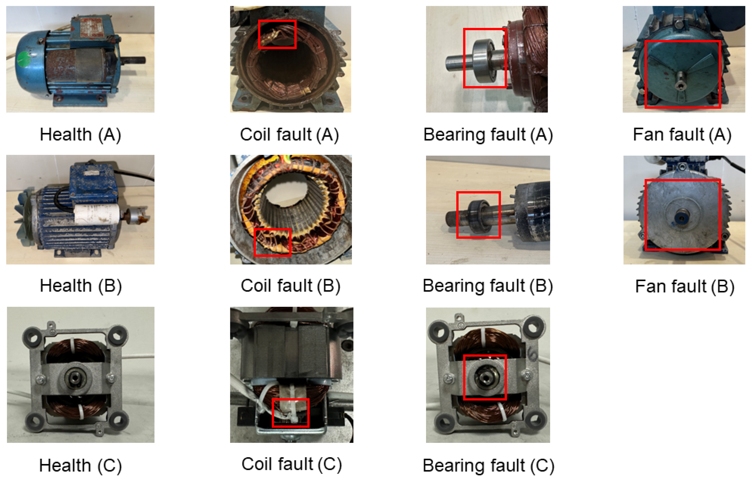
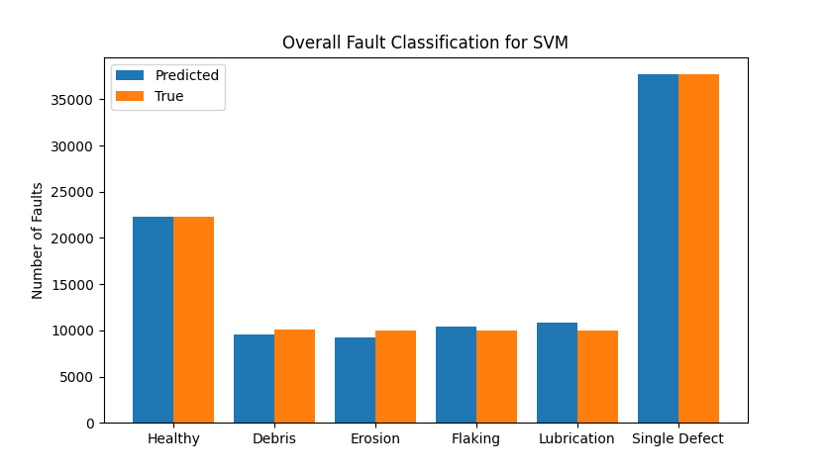
Houston
High School
Students
Research
Motor diagnostics based on Vibrations
¹David Liu and ²Wendy Duan
¹Taylor High School, ²Jordan High School
Background
Methods and Materials
Electric motors are critical components in countless industrial applications, powering machinery, tools, and equipment across sectors such as manufacturing, transportation, and energy. Ensuring the reliable operation of these motors is essential to maintain productivity, minimize downtime, and reduce maintenance costs.
Vibration analysis has emerged as one of the most effective non-invasive techniques for diagnosing motor health. When a motor operates, it generates characteristic vibration patterns. These patterns change in response to mechanical or electrical faults, such as bearing faults, rotor imbalance, etc.
This research focuses on detecting bearing faults by machine learning.
Dataset: Motor vibration dataset, provided by Partner University.
Preprocessing: Standard Scaler, transforms data so that the mean value is 0 and standard deviation is 1
Models: Trained two models
Convolution Neural Network (CNN): 7 layer (8, 8, 16, 32, 512, 32, 16, 8)
Support Vector Machine (SVM): decision function = one vs one
Control: Linear regression model
Evaluation: 90% test, 10% train, measured: MSE, Time for Predication, Accuracy.
Visualization: Plotted predictions (image on right).
Results
Conclusion
Accuracy of SVM: was 0.96284
Accuracy of CNN: was 0.98378, MSE is 0.0428.
999 – 1000 us per prediction
By contrast the accuracy of control (mx + b) where m is a matrix and b is a vector regression is 0.1935 with MSE 2.2049
Bearing faults examples
CNNs and SVMs demonstrate high accuracy for detecting and forecasting bearing faults by measuring vibration. This enables solutions for industrial companies to minimize downtime and reduce maintenance costs. The project also illustrates machine learning techniques’ potential to revolutionize motor diagnostics as they also can evaluate data in real time due to their fast prediction speed. Future work could be done to explore more complicated models such as transformers and real-time analysis based on experimental results.
Research Questions
How can machine learning techniques be used to anticipate and identify faults in AC motors based on vibration data? Can classical models such as support vector machines and convolutional networks achieve accurate, real-time predictions with minimized errors?
Acknowledgments
References
We would like to thank the partner university for providing us with data. We would also like to thank Dr. Duan Yao and Dr. Peter Liu for their unwavering support. Finally, we would like to thank IEEE IEMDC 2025 for giving us this opportunity to present our research.
API design for machine learning software: experiences from the scikit-learn project, Buitinck et al., 2013.
Scikit-learn: Machine Learning in Python, Pedregosa et al., JMLR 12, pp. 2825-2830, 2011.
TensorFlow, “Keras Sequential Model,” 2023. [Online]. Available:
https://www.tensorflow.org/api_docs/python/tf/keras/Sequential

